Slide 1
QMST 5335
Further Simio Modeling

Slide 2
Learning Objectives
Understanding SMORE plots and how to use them
Learning Referenced Properties and how to use them to compare different scenarios
Using basic Data tables in Simio

Slide 3
Outline
ATM Example, Responses, and SMORE Plots
More Simio, Referenced Properties, and Scenarios
Using basic Data tables in Simio

Slide 4
Outline
ATM Example, Responses, and SMORE Plots
More Simio, Referenced Properties, and Scenarios
Using basic Data tables in Simio

Slide 5
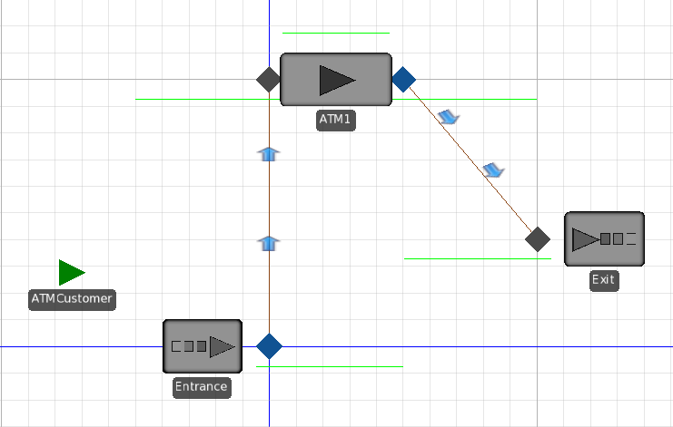
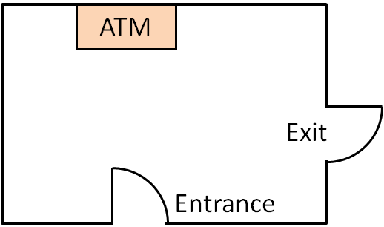
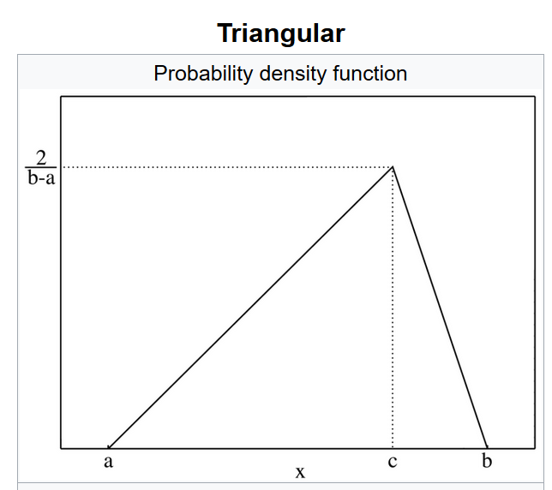
ATM Example
Model:
  Service time (ATM processing time) →Triangular distribution with (0.25, 1.0, 1.75) minutes
  Interarrival time → Exponential distribution with mean 1.25 minutes
See ‘ATM.spfx’ file for the completed model.
https://en.wikipedia.org/wiki/Triangular_distribution

Slide 6
SMORE Plots
In simulations it is common to measure the risk of statistical error.
  The half-width in the pivot table is a measure of statistical error.
  “Should I adjust warmup, replications, or replication length to make more reliable predictions?”
It is often important to analyze the risk of performance error.
  “Although the projection of average profitability is acceptable, What is my risk of a loss?”
Simio Measure of Risk and Error → SMORE Plots:
  Adds performance risk assessment to typical assessment of statistical error.
  Evaluate single scenario or compare multiple scenarios.
  SMORE provides additional graphical and numeric data to support such analysis.
  SMORE has many different components which may be enabled separately.
    Includes optional histogram, replication points and horizontal display (default vertical)

Slide 7
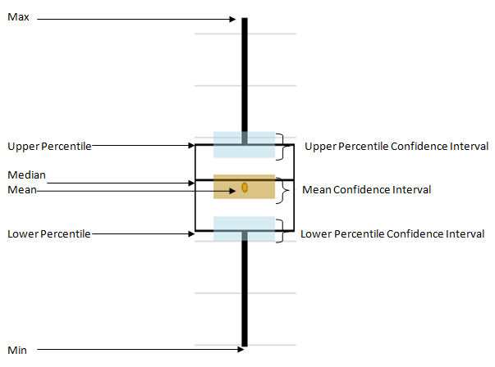
SMORE Plots
SMORE plot:
→The main parts of each graphic are as illustrated. You will get one of these for each scenario.
→The upper and lower percentile values as well as the desired confidence level are configurable.
→You can optionally display the data points and a histogram of the data.

Slide 8

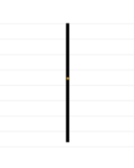
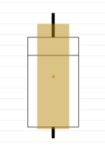
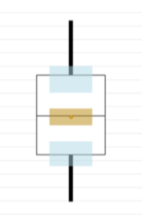
SMORE Plots
1 Replication
  Single Response Value
2-5 Replications
  Maximum, Minimum, and Mean
6+ Replications
  Upper + Lower Percentiles, Median, Mean Confidence Interval
Enough Reps for Statistically Valid Results
  Confidence Intervals for Upper + Lower Percentiles

Slide 9
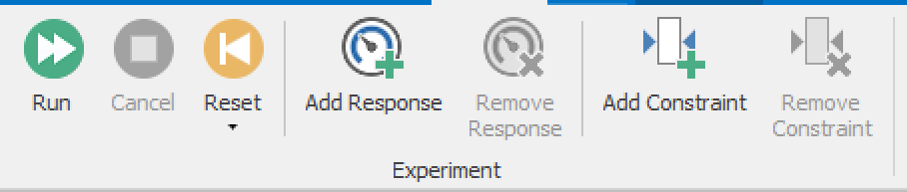
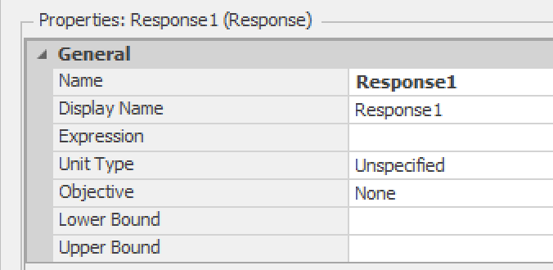
SMORE Plots
How to add SMORE plots?
  Experiment → Add Response
Give a nice meaningful name
This is where you define what value you will be looking at
→Use the Expression Editor to find what you want

Slide 10
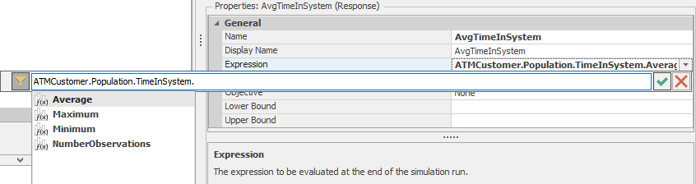
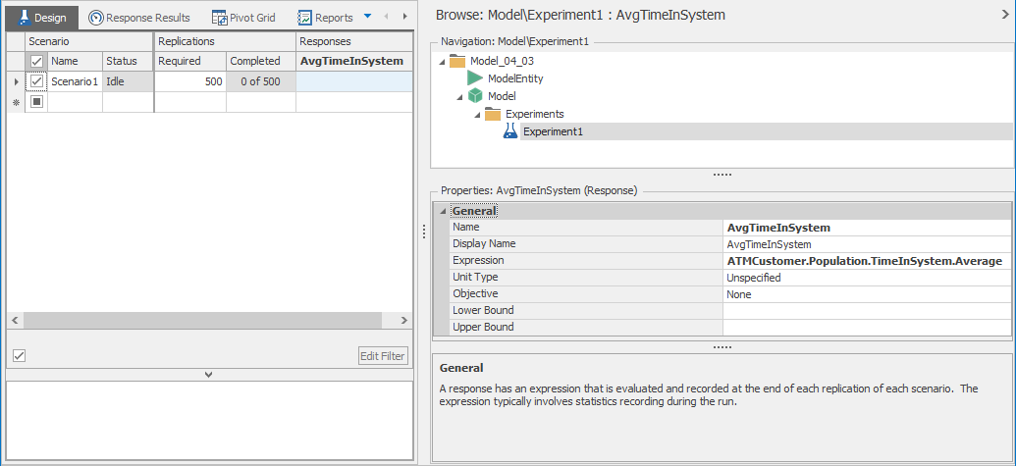
SMORE Plots
Adding a Response for avg. time in system!

Slide 11
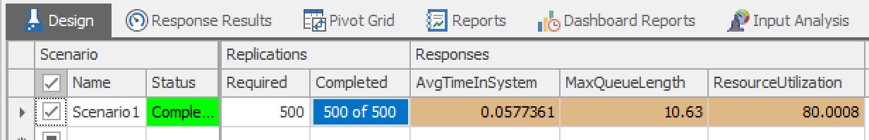
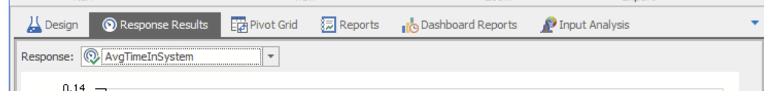
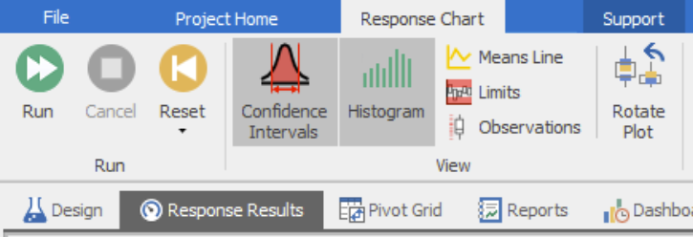
SMORE Plots
Where are they?
  After you run the experiment, go to Response Results
  Select whichever response you want to see from the menu
  You can modify what you want to see

Slide 12
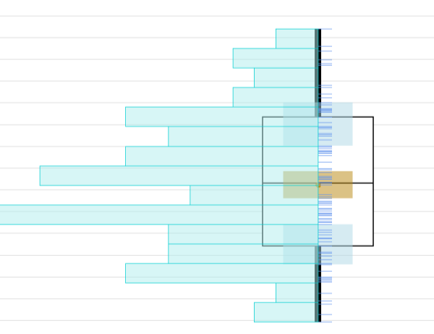
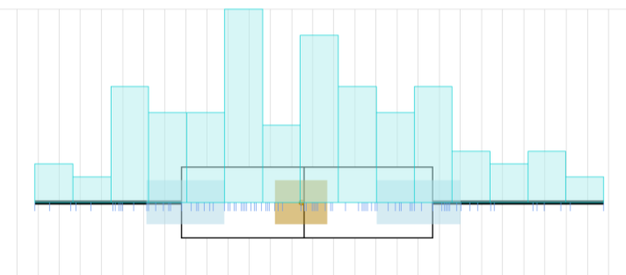
SMORE Plots
More to see..
  You can enable a histogram for a better summary of the data spread.
  You can enable the raw data – each replication shows as a short blue line.
  Can view the spread of raw data Vertically or Horizontally
    Sometimes the horizontal view displays data better than the vertical view.

Slide 13
Outline
ATM Example, Responses, and SMORE Plots
More Simio, Referenced Properties, and Scenarios
Using basic Data tables in Simio

Slide 14

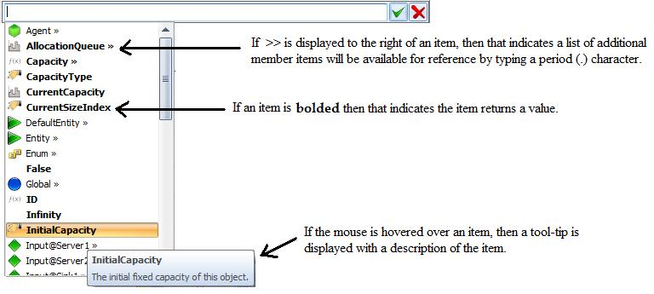
Simio Language
Simio uses a “dot" notation for addressing an object's data such as its properties & states.
The general form is “xxx.yyy" where yyy is a component of xxx.
  Server1.Capacity.Allocated.Average provides the average allocated capacity for Server1.
Editing object properties:
  Displayed in Properties Window, Defined by object builder
  Expression editor (down arrow at right), Results are filtered by default

Slide 15
Simio Language
Common expressions:
  X (a number – integer or real)
  Random.Exponential(mean)
  Random.Triangular(min, mode, max)
  Random.Uniform(min, max)
  Math.{Lots of choices}
  ServerName.Capacity.ScheduledUtilization
  ServerName.InputBuffer.Contents
  DefaultEntity.Population.TimeInSystem.Average
  DefaultEntity.Population.NumberInSystem.Average
  SinkName.InputBuffer.NumberEntered
  SinkName.TimeInSystem.Average
Key
Keyword
Object Name
Station Name

Slide 16
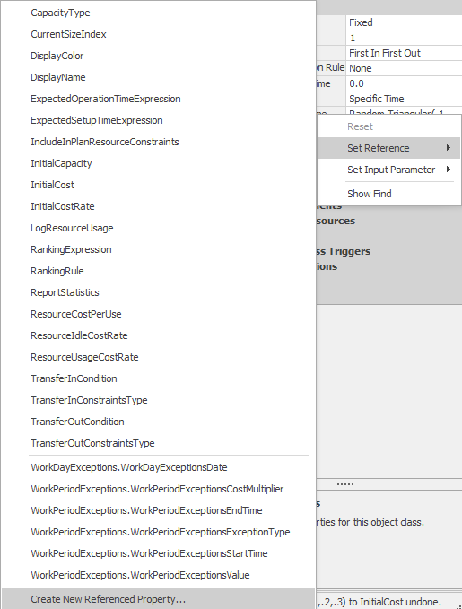
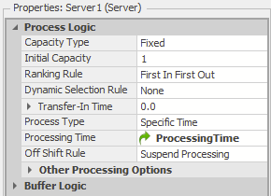
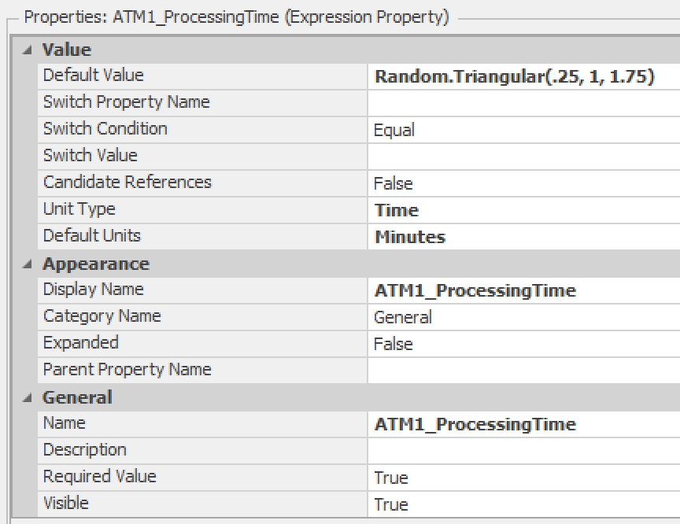
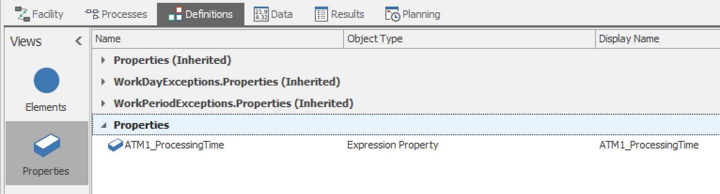
Referenced Properties
Reference Properties can be defined for any property!
See (remove, edit) them Definitions→Properties

Slide 17
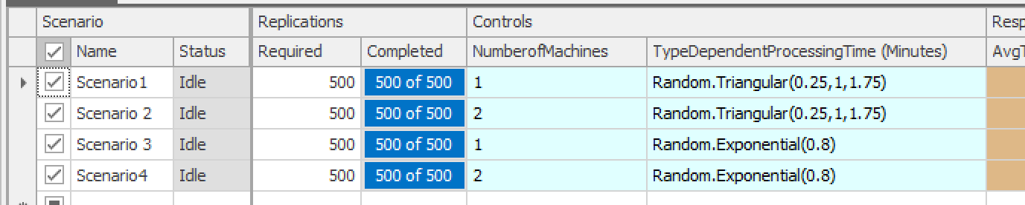
Referenced Properties
Once you define Reference Properties
  You can see them in the Experiment Design as Controls!
  Using Controls, you can define several scenarios and compare them in terms of the specific responses

Slide 18
Referenced Properties
ATM Example revisited:
  Consider the following scenarios for the ATM station
    Scenario 1: Current Situation - The Station has one ATM of the current type → ATM of this type has processing time distributed with Triangular distribution (T) with (0.25, 1.0, 1.75) minutes → M/T/1 system
    Scenario 2: Get one more of ATM of the same type → M/T/2 system
    Scenario 3: Replace the current ATM with a new type → ATM of new type has processing time distributed with Exponential distribution with mean 0.8 minutes → M/M/1 system
    Scenario 4: Replace the current ATM with two new type of ATMs → M/M/2 system
  We want to compare these scenarios based on:
    Average time a customer spends in the system
    Maximum # of customers observed in the queue
    Average utilization of the ATM
    Average time a customer spends in the queue

Slide 19
Referenced Properties
ATM Example revisited:
  We want to compare these scenarios based on several metrics, so for each metric, we add a response (done in the Experiment window)
    Average time a customer spends in the system → name ‘AvgTimeInSystem’
    Maximum # of customers observed in the queue → name ‘MaxQueueLength’
    Average utilization of the ATM → name ‘ResourceUtilization’
    Average time a customer spends in the queue→ name ‘AvgQueueWaiting’
      We can do this after defining scenarios too
We had added responses for these already
→ You can give the names however desired

Slide 20
Referenced Properties
ATM Example revisited:
  To compare the 4 scenarios, we will use reference properties and then define scenarios accordingly (done in the Model window)
    The properties changing in the scenarios:
      Number of ATMs (i.e., number of servers, which is the capacity of the ATM server objective)
      And processing time distribution of the ATM
    So, we can define two Reference Properties
      One for the ‘InitialCapacity’ → named “NumberofMachines”
      One for the ProcessingTime → named “TypeDependentProcessingTime”
  To do so:
    Right click on a property → select ‘Set Reference’ → select ‘Create New Referenced Property’

Slide 21
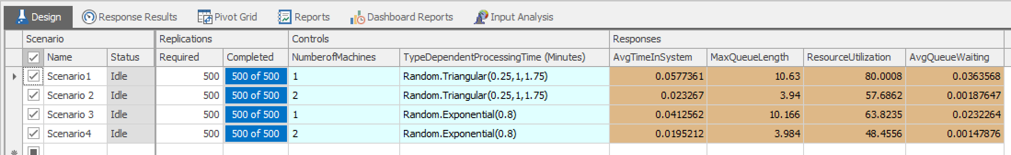
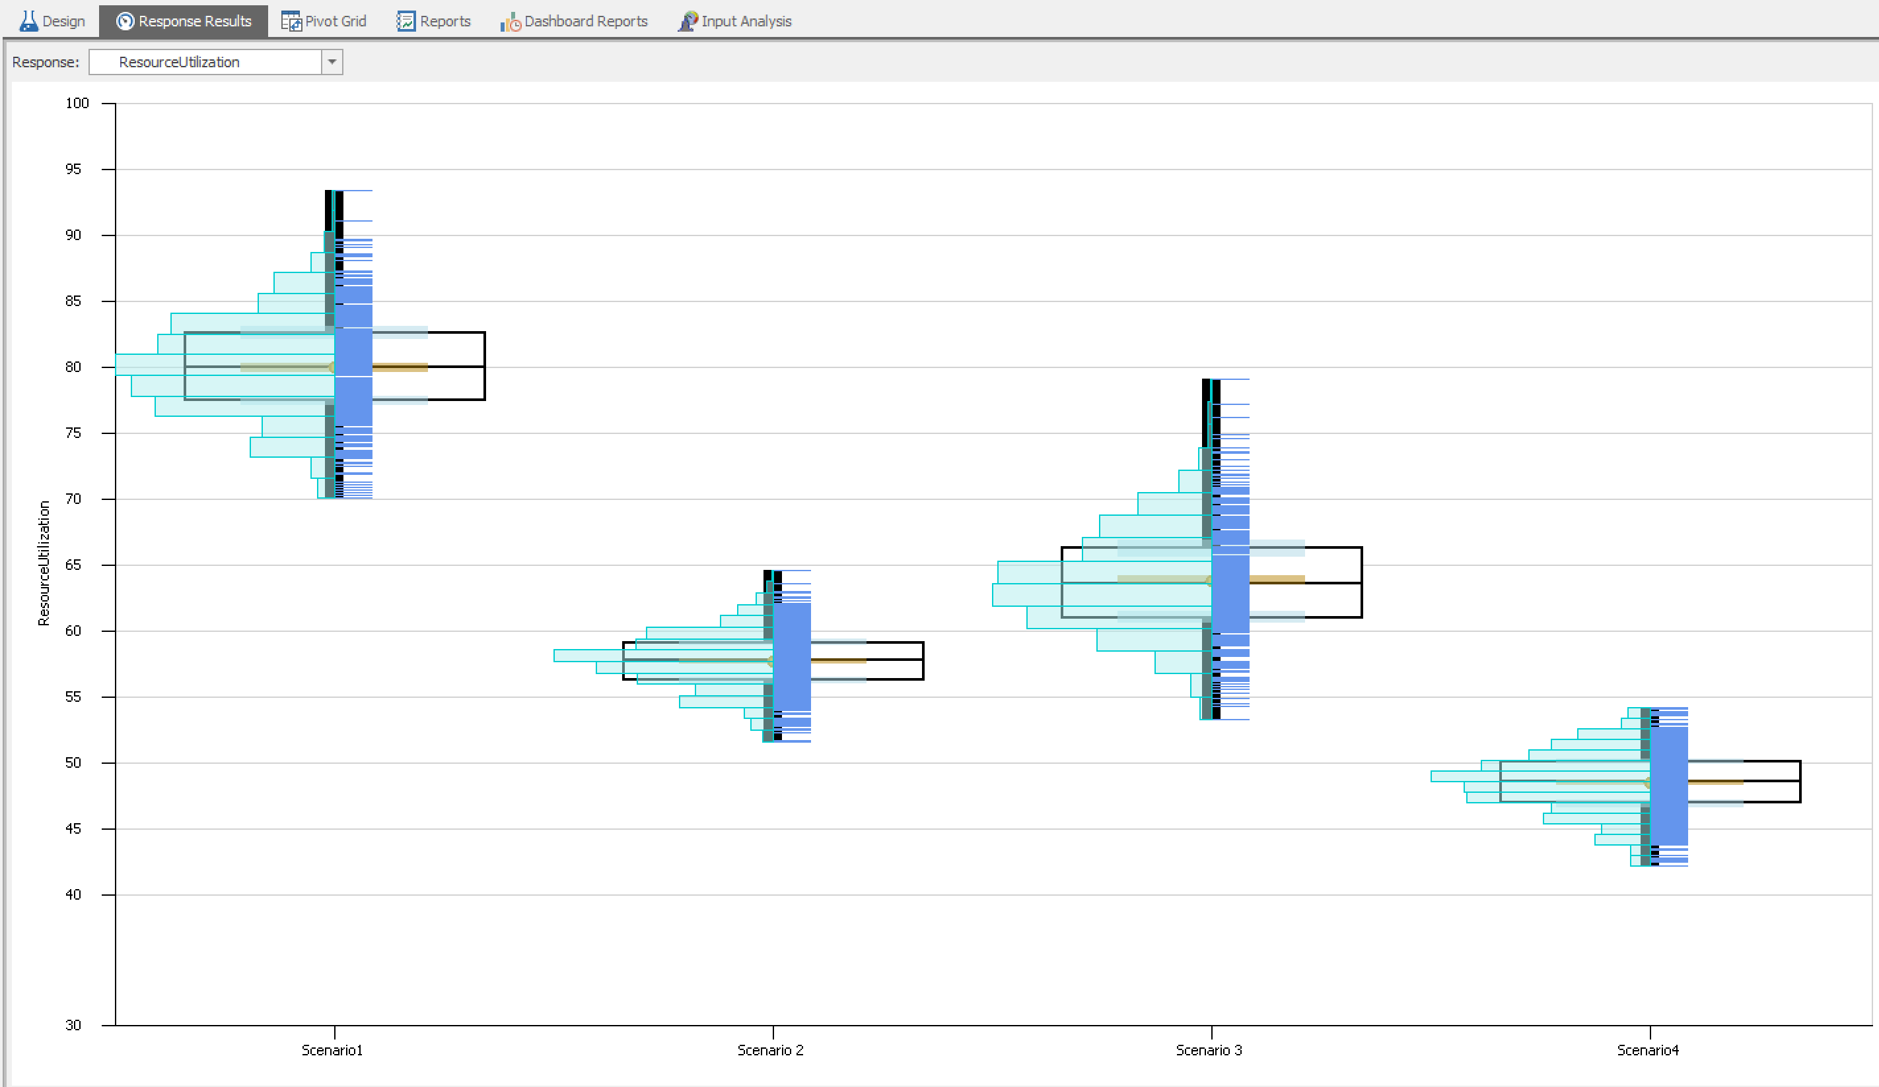
Referenced Properties
ATM Example revisited:
  When you go to experiment design
    Current Scenario: Scenario 1 → with default values of the Referenced Properties shown under Controls column!
    Just Add scenarios and change the values of the Referenced Properties based on the Scenario definitions
See ‘ATM– Scenarios.spfx’ for the completed model.

Slide 22
Outline
ATM Example, Responses, and SMORE Plots
More Simio, Referenced Properties, and Scenarios
Using basic Data tables in Simio

Slide 23
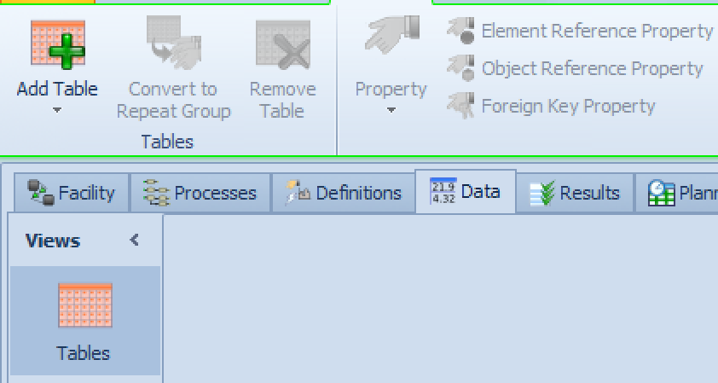
Data Tables
Models often have large amounts of data that describe the different objects and entities that move through the system.
  It is slow and inconvenient to repeatedly access the external data as the model is running. Simio brings the data into memory for fast access
  Simio can represent data in simple tables or in complete data sets with multiple relations.
  The data schema for the tables are user-defined.
To add Tables
  In model window:
    Data → Tables → Add Table
External
Data
Data is imported and held in memory for direct and fast access by the model.
Data Tables
Simio
Model

Slide 24
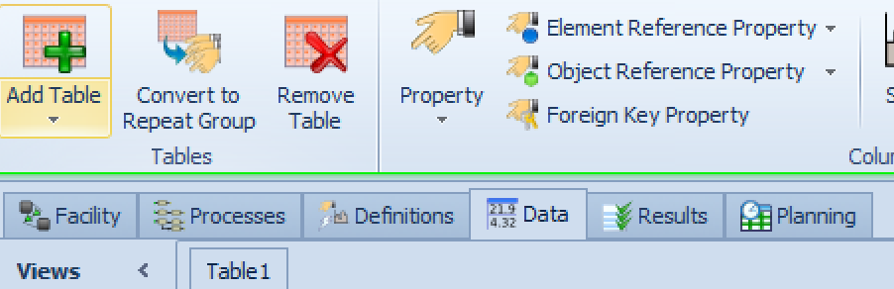
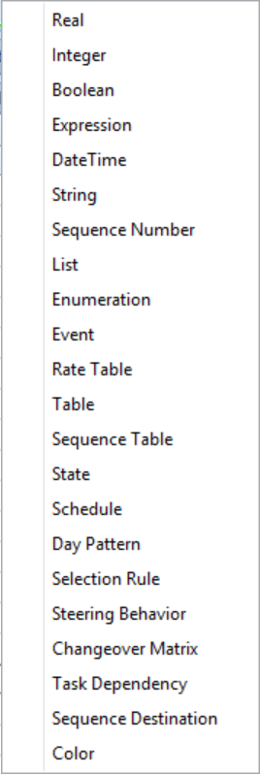
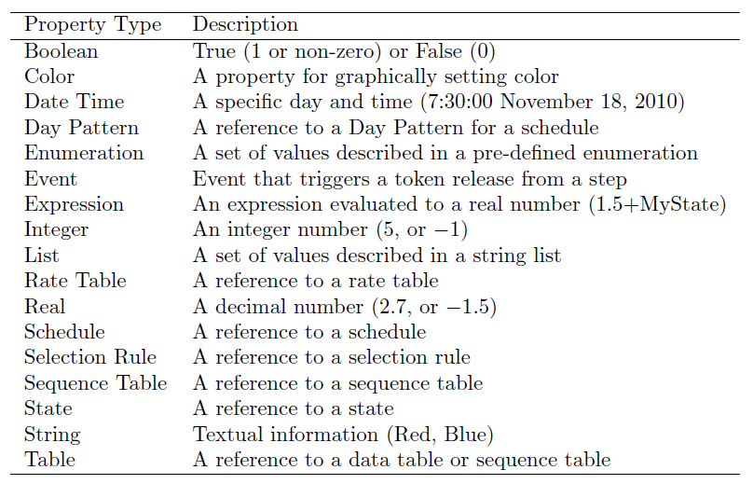
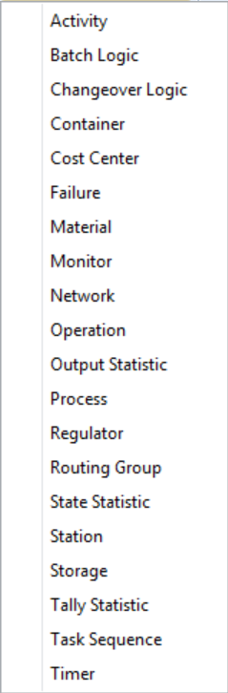
Data Tables
To add a column, select a table and select what type of column you are going to add:
  Standard Property, Element Reference,
  Object Reference, Foreign Key
Standard Properties:
Element Reference:
Object Reference:
Use when you want the table to refer to an object or set of objects

Slide 25
Data Tables
Tables have columns and rows.
  Columns are standard properties or references to objects or elements.
  A table value can be referenced by row and column using the syntax:
    TableName[RowNumber, ColumnNumber]
    TableName[RowNumber].ColumnName
  An object may have an active reference to a row in the table. In this case a table value can be referenced as: TableName.ColumnName
  Other table functions:
    TableName.AvailableRowCount
    TableName.PropertyName.RandomRow
A column is defined by a strongly typed property.
A row may be referenced by an object or entity.

Slide 26
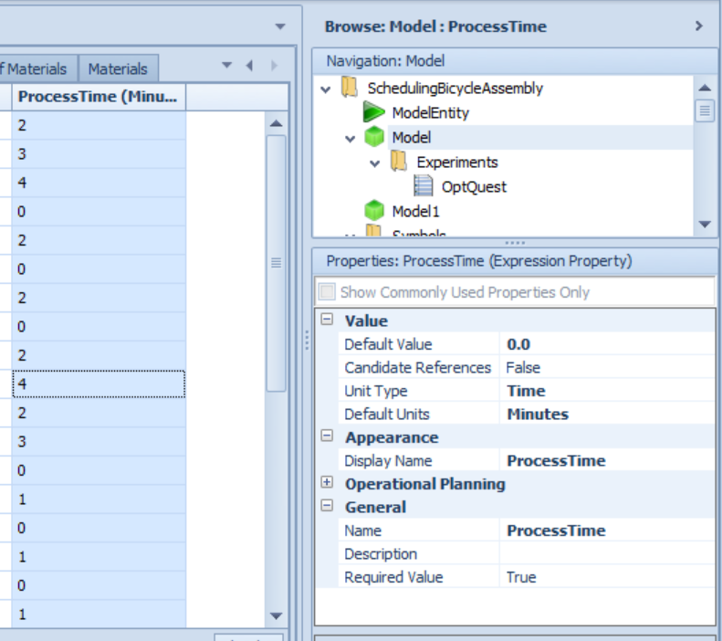
Data Tables
Select a Table’s column to see its properties
  Change column name
  Required Value allows cells to be blank
  Numeric and Expression Columns have Unit Type and Default Unit Properties
You can add a numeric column to your table that specifies the weighting of each row (or entity type).
  Specify that you'll randomly select a row based on that column by using the function TableName.ColumnName.RandomRow.
  SimBit: SelectEntityTypeFromTable
Let’s solve an Example

Slide 27
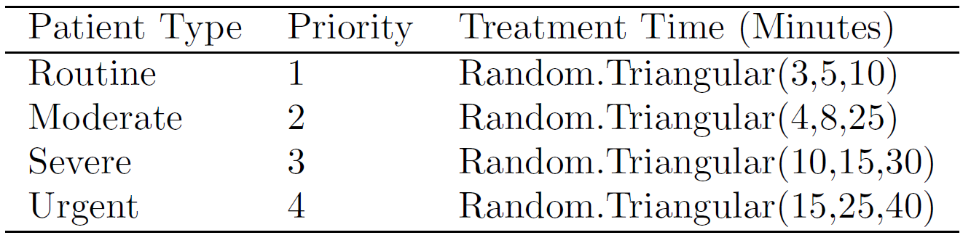
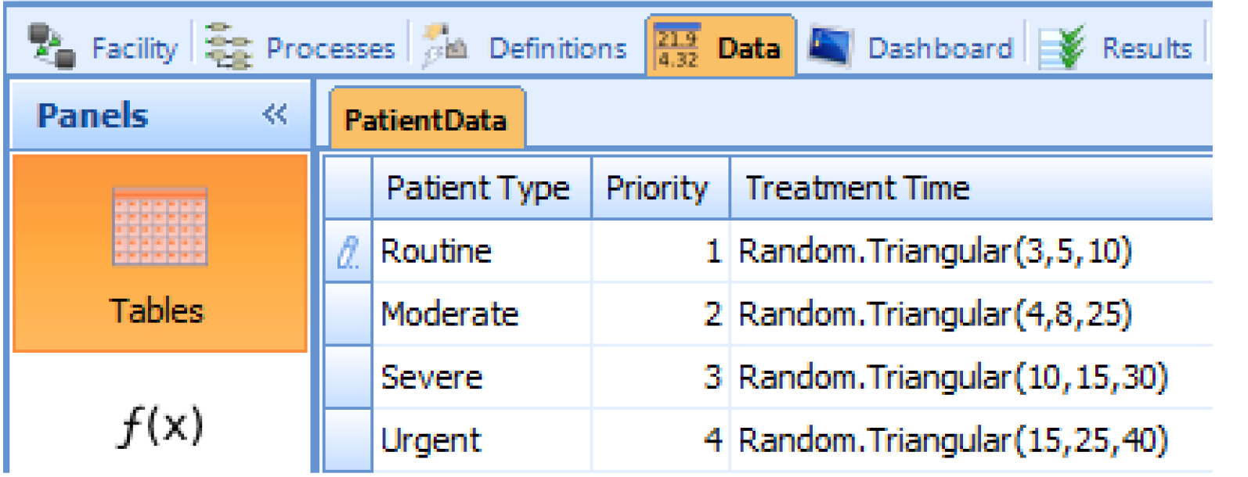
Data Tables
An Emergency Department Example:
  4 patient types
    Different treatment times, priorities
    Suppose that patient mix is:
      Routine 40%, Moderate 31%, Severe 24%, Urgent 5%
    Arrival rate of patients: 15/hour → Random.Exponential(4)
  On Simio, first create 4 types of Entities → One for each patient type
  Data→Tables→Add table: ‘PatientData’ table
    Use Object Reference for the first column ‘Patient Type’
      Select the Entities
    Use Standard Property and select integer for priorities
      Define the priorities of the patients accordingly
    Use Standard Property and select Expression for treatment times
      Enter the expressions accordingly
See ‘Emergency Department.spfx’.

Slide 28
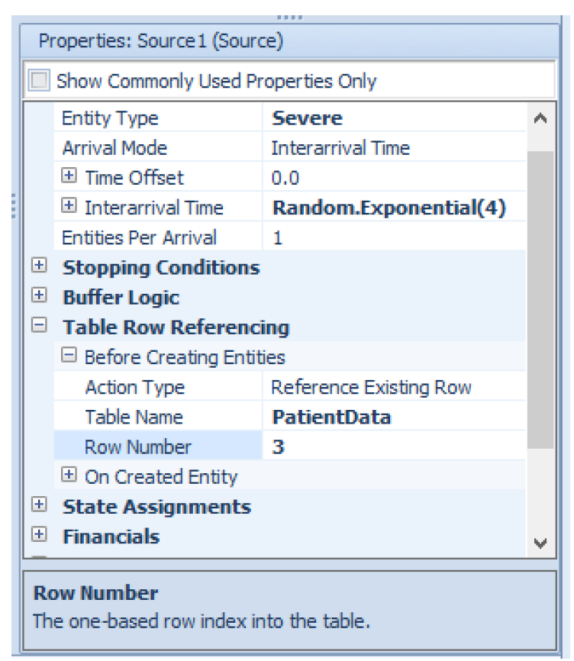
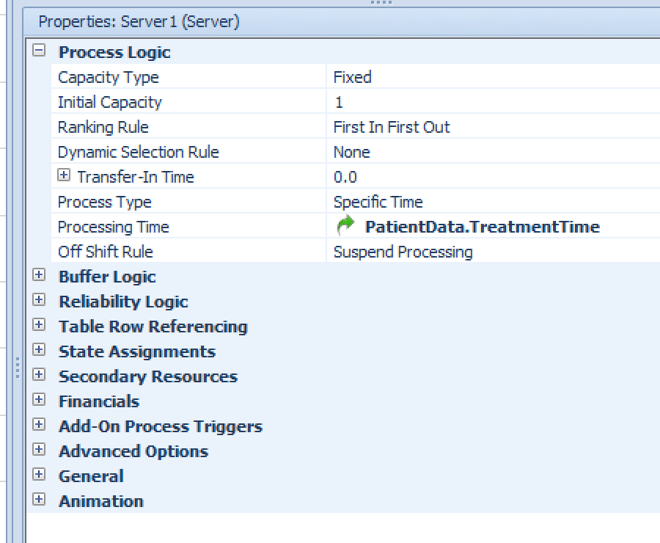
Data Tables
An Emergency Department Example:
  We can refer to our table now!
  Need to create a source for each entity?
  How about entities are to be selected randomly based on some proportions?

Slide 29
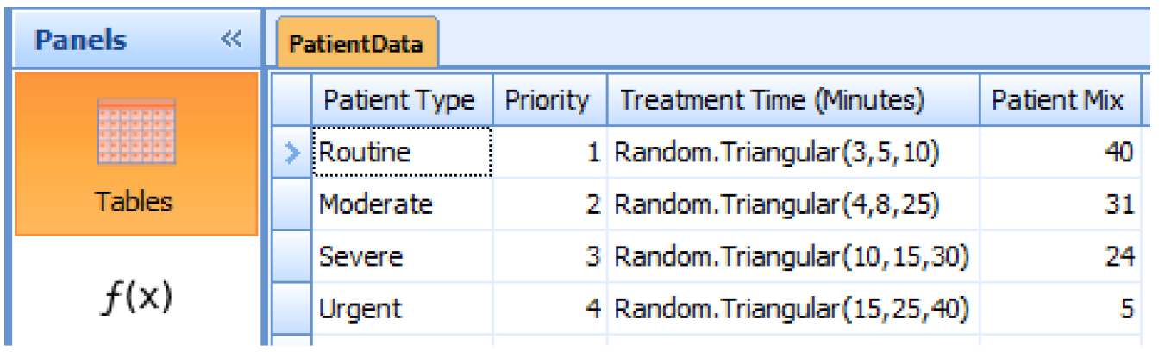
Data Tables
An Emergency Department Example:
  Recall that patient mix is:
    Routine 40%, Moderate 31%, Severe 24%, Urgent 5%
    Add a column to the table using Standard Property ‘Real’, name column, let’s say, Patient Mix
  You can add a numeric column to your table that specifies the weighting of each row (or entity type).
  Specify that you'll randomly select a row based on that column by using the function TableName.ColumnName.RandomRow.
    SimBit: SelectEntityTypeFromTable

Slide 30
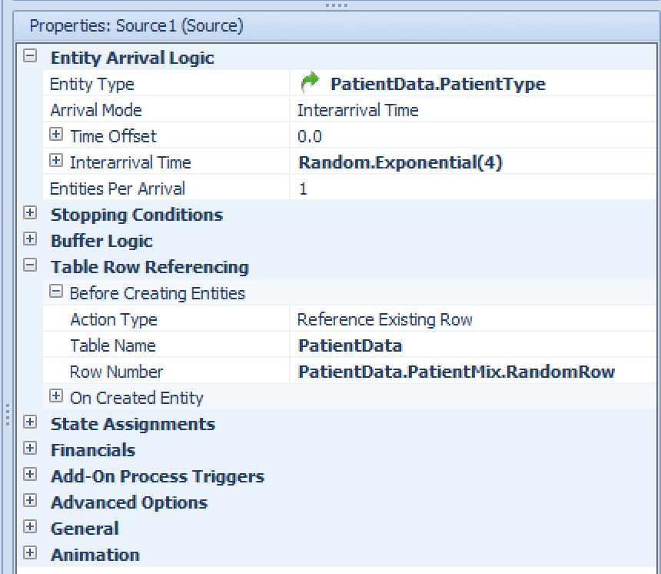
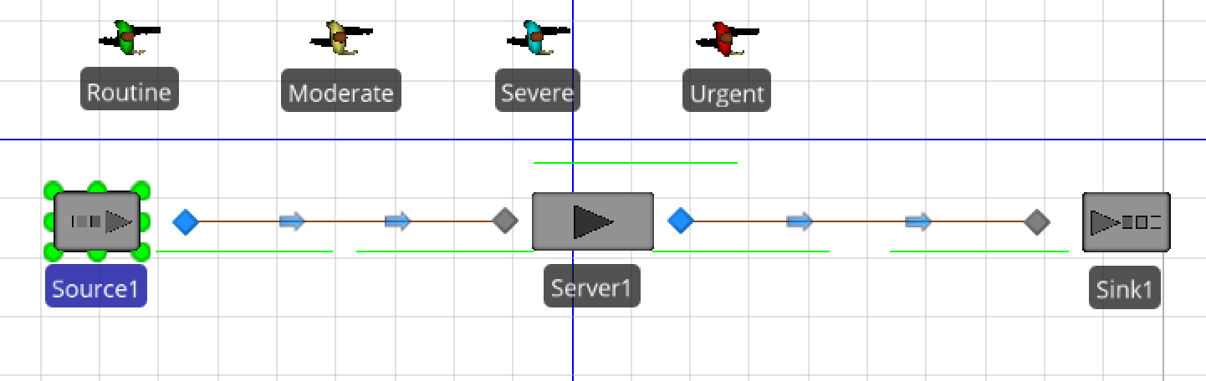
Data Tables
An Emergency Department Example:
  In the Source object, associate entity type from the table, selected randomly based on the PatientMix column

Slide 31
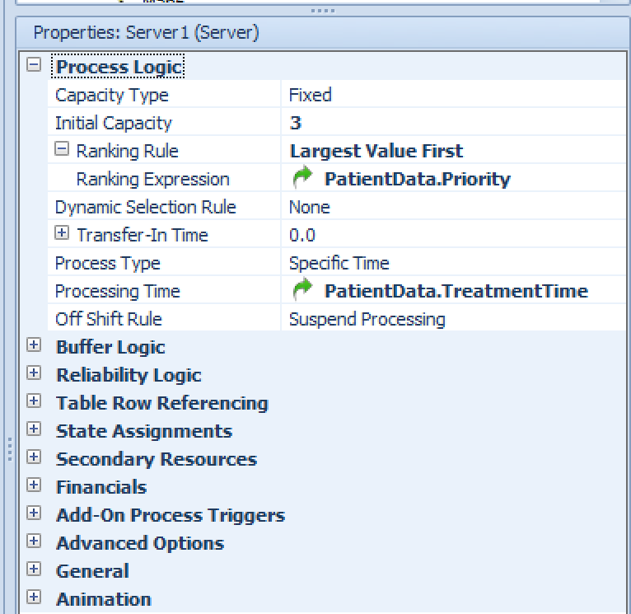
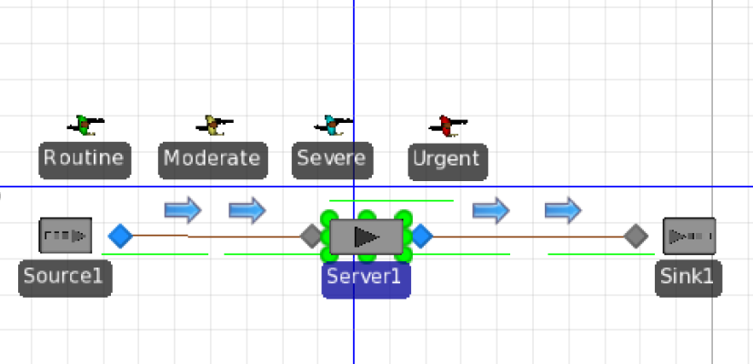
Data Tables
An Emergency Department Example:
  Say we have 3 doctors, so capacity of the server is 3
    In processing time → select PatientData.TreatmentTime
  Also, we want to respect the patient priorities:
    Ranking rule → Largest Value First
    Ranking Expression → PatientData.Priority

Slide 32
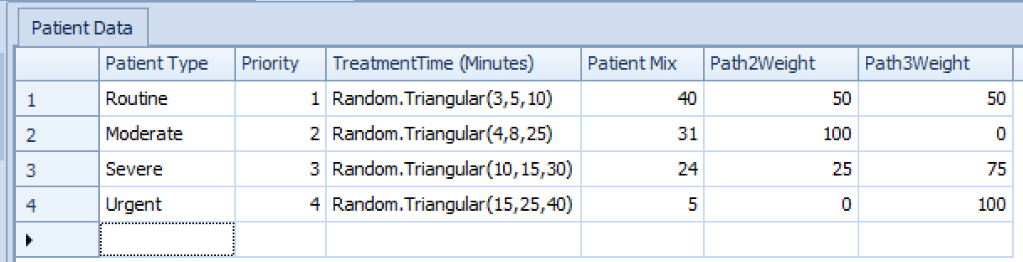
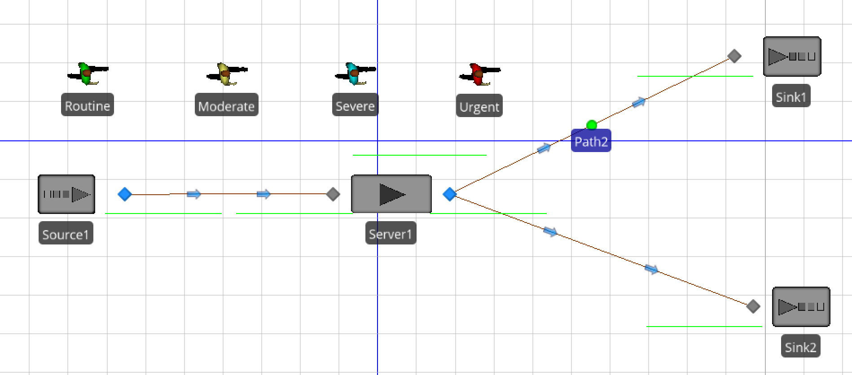
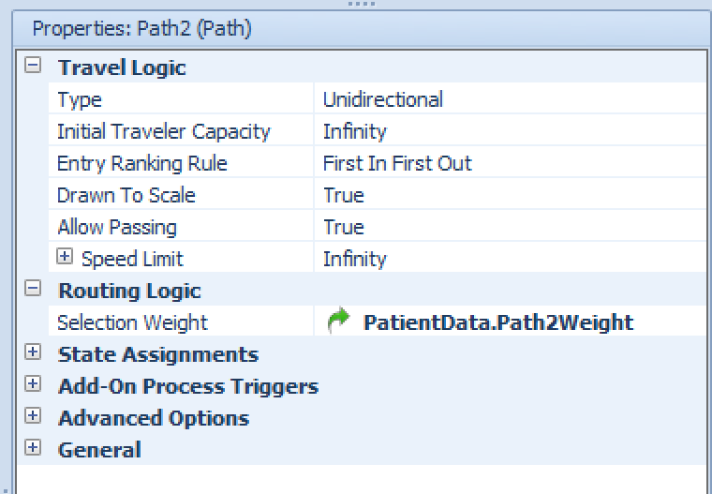
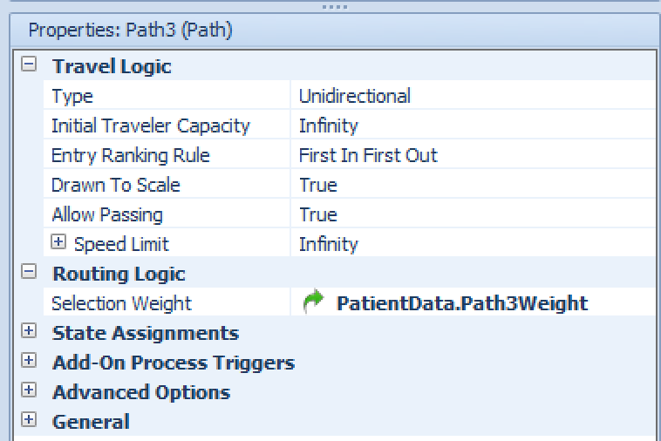
Data Tables
An Emergency Department Example:
  Say we have two possible exits:
    Each patient type has different probability

